Slide 1


2015 FINANCIAL REPORT
PRESENTATION AT CEEC’S EGM/AGM 2016
MARCH. 05th 2016
BY: Csaba Bundik
CEEC’s Vice-Chairman

Slide 2

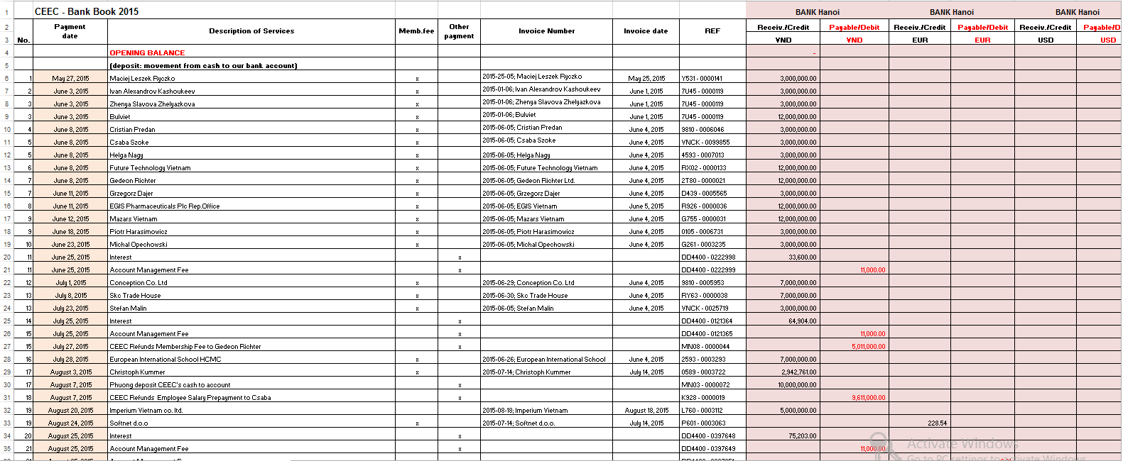
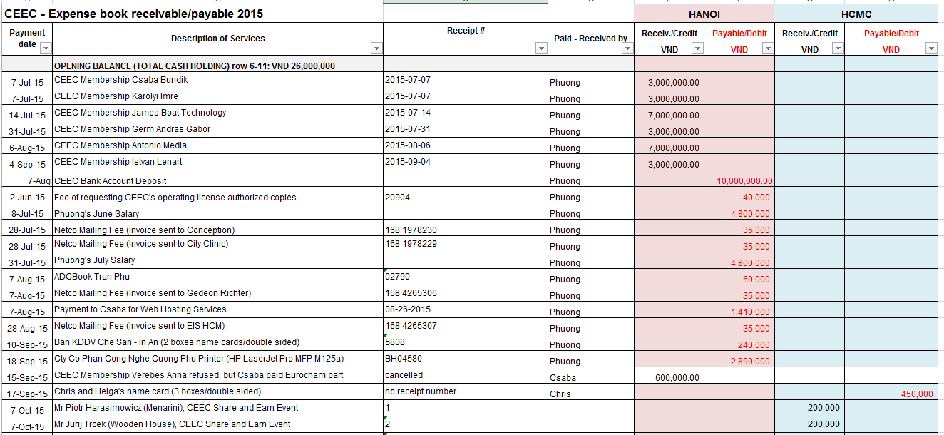
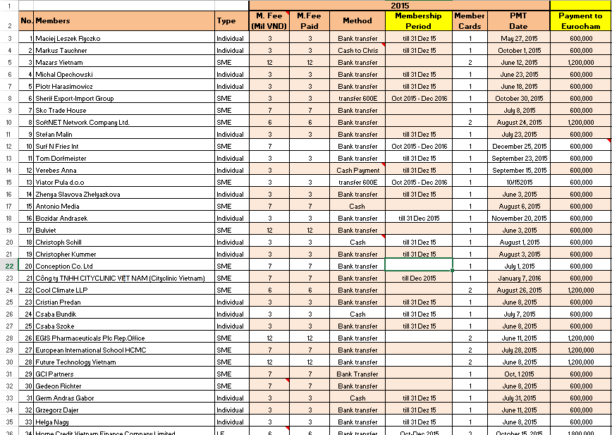
CEEC Bank Book: Record of all transactions through CEEC’s bank account
CEEC Expense Book: Record of all transactions in cash from Hanoi & HCM
CEEC Members & Prospect List: List of CEEC members and their payment

Slide 3
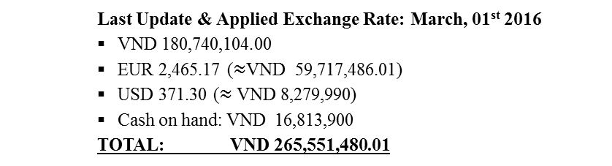
2015 STATEMENT OF FINANCIAL POSITION
RECONCILIATION:
Last Update & Applied Exchange Rate: March, 01st 2016
VND 180,740,104.00
EUR 2,465.17 ($≈$VND 59,717,486.01)
USD 371.30 ($≈$VND 8,279,990)
Cash on hand: VND 16,813,900
TOTAL: VND 265,551,480.01

Slide 4
2016 BUDGET PROJECTION- Worst case Scenario
Individual Renewed: 10
Expected new individual member: 7
(Pro-rata rate non-applicable)
SME Renewed: 19
Expected new SMEs member: 6
(Pro-rata rate applicable)
Share & (L)Earn: CEEC bi-monthly event

