Slide 1
MARCH, 5th 2016
ELECTION OF 2016 EXECUTIVE COMMITTEE

Slide 2
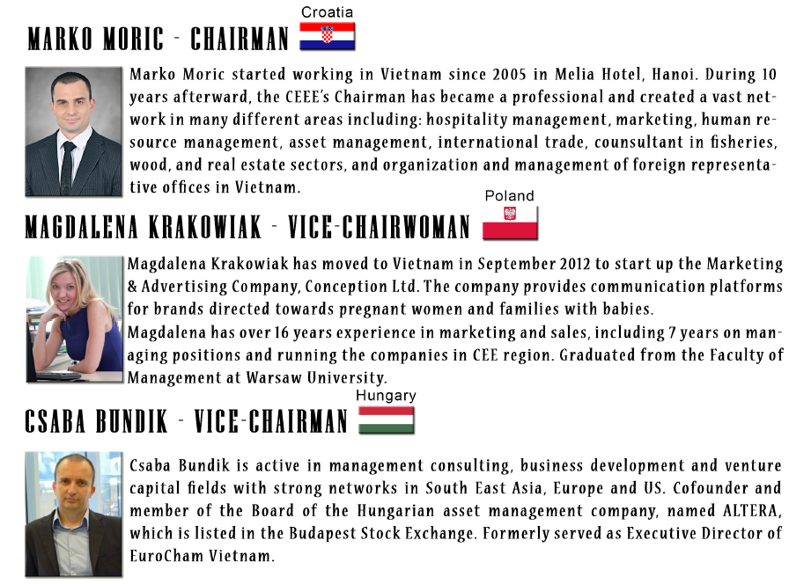
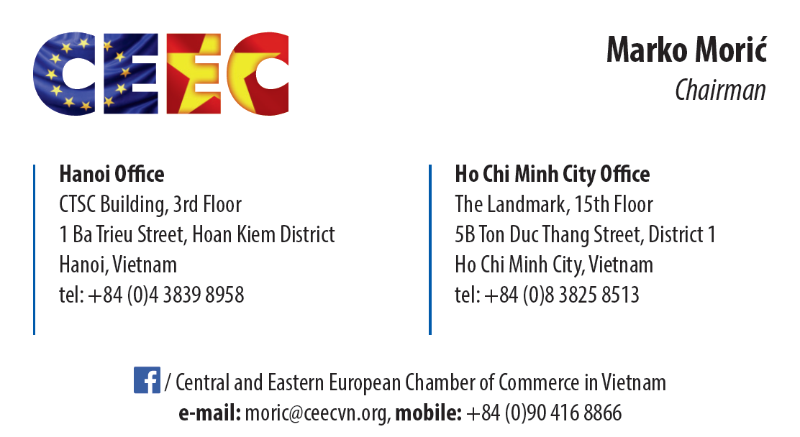
CEEC 2015 EXECUTIVE COMMITTEE
Marko Moric started working in Vietnam since 2005 in Melia Hotel, Hanoi. During 10 years afterward, the CEEE’s Chairman has became a professional and created a vast network in many different areas including: hospitality management, marketing, human resource management, asset management, international trade, consultant in fisheries, wood, and real estate sectors, and organization and management of foreign representative offices in Vietnam.
Magdalena Krakowiak has moved to Vietnam in September 2012 to start up the Marketing & Advertising Company, Conception Ltd. The company provides communication platforms for brands directed towards pregnant women and families with babies.
Magdalena has over 16 years experience in marketing and sales, including 7 years on managing positions and running the companies in CEE region. Graduated from the Faculty of Management at Warsaw University.
Csaba Bundik is active in management consulting, business development and venture capital fields with strong networks in South East Asia, Europe and US. Cofounder and member of the Board of the Hungarian asset management company, named ALTERA, which is listed in the Budapest Stock Exchange. Formerly served as Executive Director of EuroCham Vietnam.

Slide 3
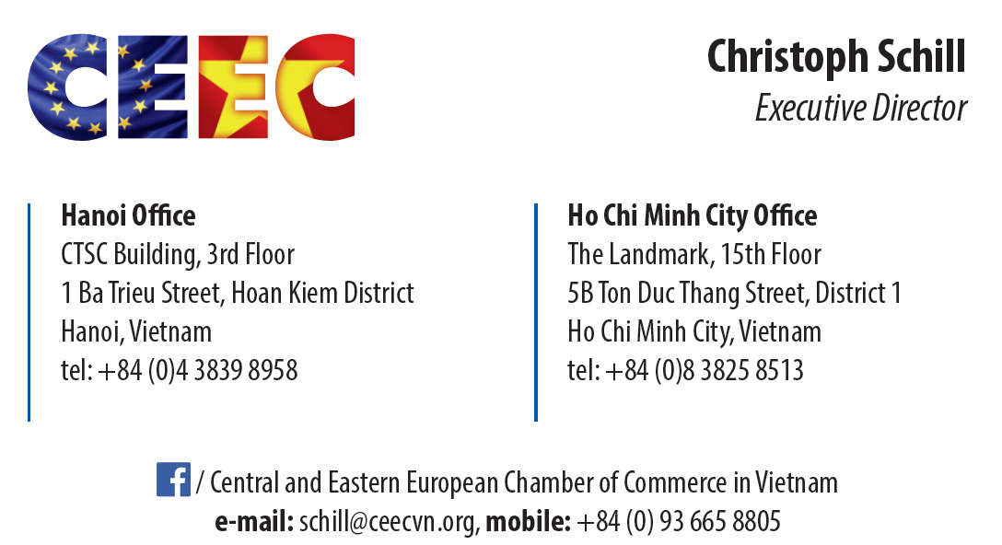
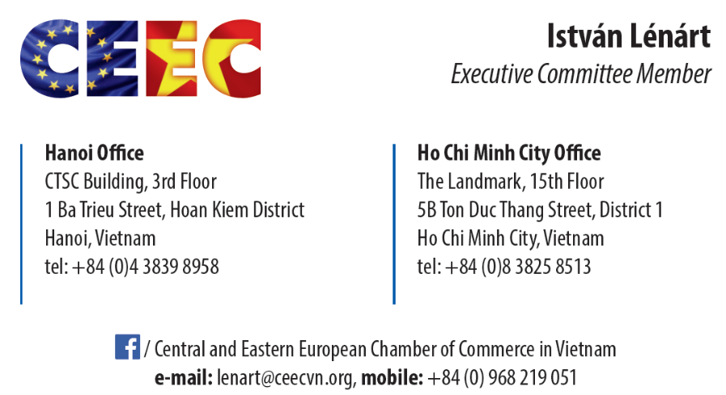
CEEC 2015 EXECUTIVE COMMITTEE
Helga Nagy draws on over 25 years of successful work in the corporate and private sector in Europe, with over 15 years residing in Vietnam and realizing challenging projects in higher education, manufacturing, operations, hospitality and the service sector. Helga has a track record as lecturer, trainer and entrepreneur and supported numerous companies to establish strategic business partnerships. Helga is active in the area of personal and professional skills development in multi-cultural business environments.
Christoph Schill has earned substantial expertise in finance and banking, human resource, project management and consultancy since 1996. The CEEC’s Executive Director first came to work in Vietnam in 2010 as an organizational development & product innovation consultant. He worked in EuroCham Vietnam as a Project Manager before taking his current green growth consultant and chief representative position at Pracsis South East Asia, a Brussels based EU service provider.
Istvan Lenart arrived to Vietnam in 2008 as representative of a Hungarian private enterprise, contractual partner of the Hungarian Investment and Trade Development Agency. He established Vietnam Office and Lao PDR Branch Office of the company. Later he worked as Commercial Attaché and Deputy Consul of the Hungarian Embassy in Hanoi. He is the former Chief Representative of SKC Trade House Ltd. in Vietnam and Former Country Representative of the Hungarian National Trading House.

Slide 4
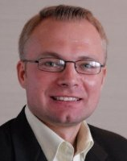
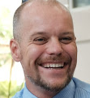
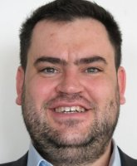
CEEC 2016 EXECUTIVE COMMITTEE: NOMINEES
BORIS GUEUDIN,
Boris Gueudin, is leading the Financial Advisory services for Mazars in Vietnam. Boris participated to numerous advisory project in Poland and Vietnam including entry strategy and company set up, due diligence, business planning and tax advisory project.
Working in Vietnam since more than 4 years, Boris has acquired a broad network in the expat community in both Ho Chi Minh City and Hanoi and a profound experience on investment specificities in Vietnam.
PIOTR HARASIMOWICZ
Coming to Vietnam since 2012, with over 15 years of hands-on experience, Piotr Harasimowicz have developed expertise in operational efficiency and business performance in industries ranging from an automotive retail/ repair business to the international chemical, pharmaceutical and nutrition industry, and from Eastern Europe to Asia.
CSABA SZOKE
Csaba Szoke had travelled the world extensively and lived in Hungary, the USA, England, Greece, and Spain before moving to Vietnam. Originally trained in the legal profession, Csaba left his corporate lawyer career behind and switched to education in 2009. Starting out as an English teacher he progressed through the ranks and eventually set up his own training business in Ho Chi Minh City. Csaba’s motto to life is “There is always room for improvement.” which he strives to apply to both his professional, and private life.
GELLERT HORVATH
After working as a political adviser in the cabinet of Enikő Győri, Minister of State for EU Affairs, Gellert Hovarth first came to Vietnam in 2012 to received his position as Deputy Head of Mission of the Embassy of Hungary in Hanoi (political, commercial and development affairs). He has in-depth knowledge in law and public administration.
VUONG THUY TIEN
Vuong Thuy Tien joined PPF Vietnam (former name of Home Credit Vietnam) since May 2012 in the position of Chief Legal and Compliance Officer. She graduated from the University of Queensland in Australia with the Master Degree on Comparative Laws and has strong knowledge and experience in legal, banking & finance. Prior to PPF Vietnam, Vuong Thuy Tien has worked in some international law firm and commercial banks, including Baker and McKenzie, Standard Chartered Bank, ABN AMRO Bank N.V. and Crédit Agricole CIB.

