Slide 1

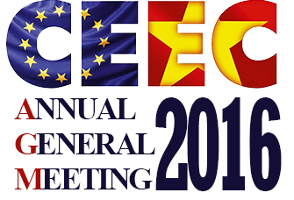
MARCH, 5th 2016
2015 REVIEW
By: Christoph Schill
CEEC’s Executive Director

Slide 2

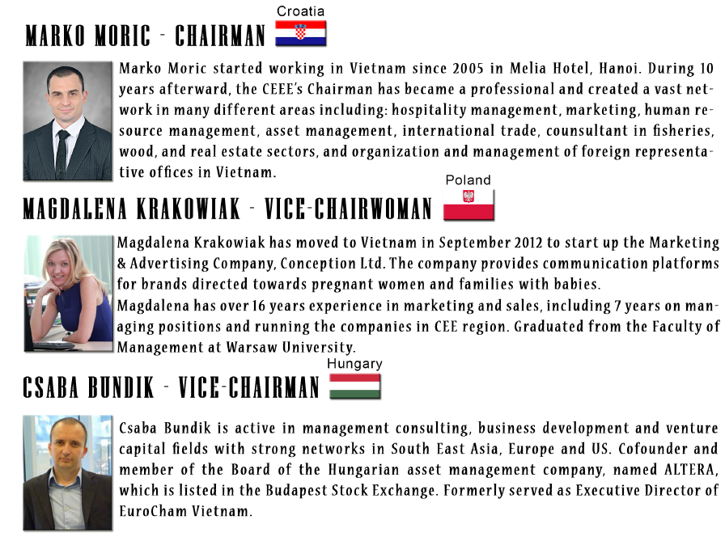
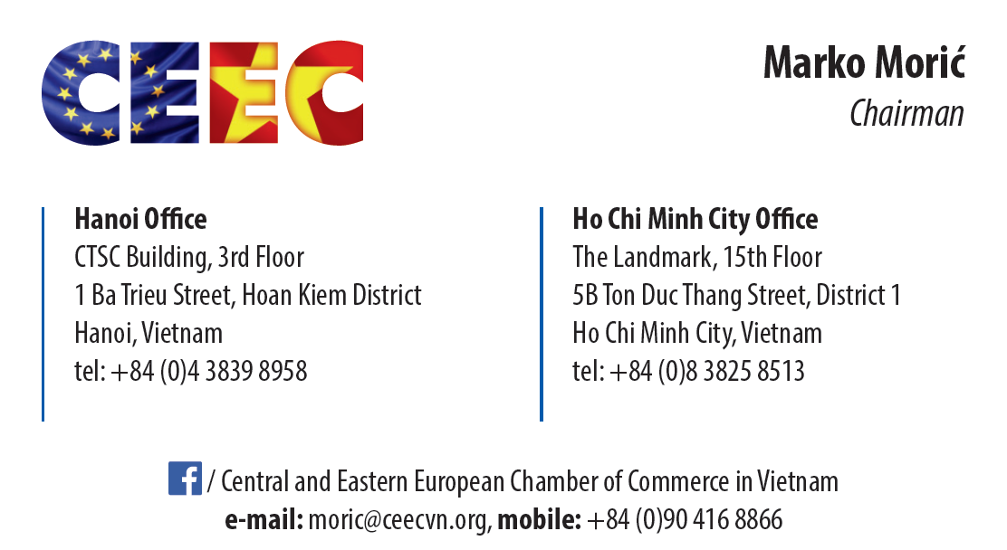
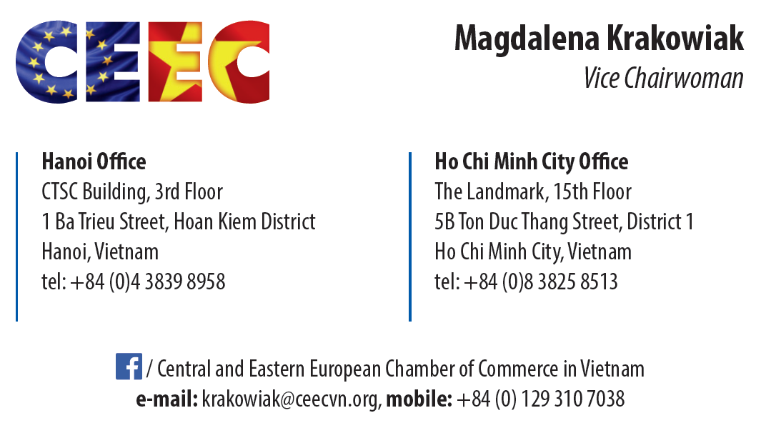
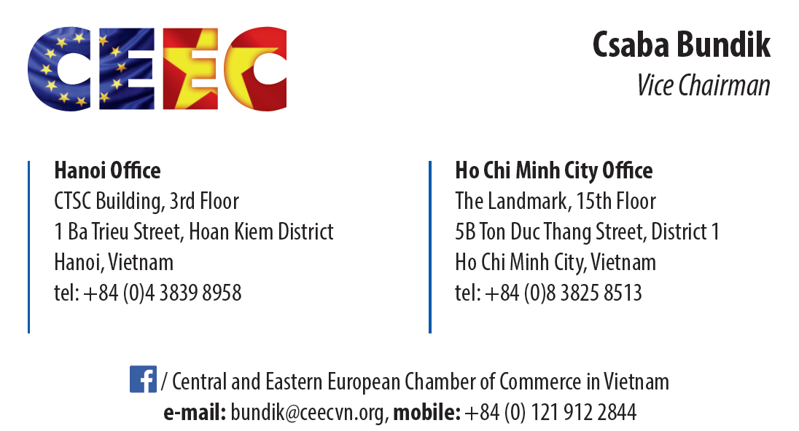
CEEC EXECUTIVE COMMITTEE
Marko Moric started working in Vietnam since 2005 in Melia Hotel, Hanoi. During 10 years afterward, the CEEE’s Chairman has became a professional and created a vast network in many different areas including: hospitality management, marketing, human resource management, asset management, international trade, consultant in fisheries, wood, and real estate sectors, and organization and management of foreign representative offices in Vietnam.
Magdalena Krakowiak has moved to Vietnam in September 2012 to start up the Marketing & Advertising Company, Conception Ltd. The company provides communication platforms for brands directed towards pregnant women and families with babies.
Magdalena has over 16 years experience in marketing and sales, including 7 years on managing positions and running the companies in CEE region. Graduated from the Faculty of Management at Warsaw University.
Csaba Bundik is active in management consulting, business development and venture capital fields with strong networks in South East Asia, Europe and US. Cofounder and member of the Board of the Hungarian asset management company, named ALTERA, which is listed in the Budapest Stock Exchange. Formerly served as Executive Director of EuroCham Vietnam.

Slide 3
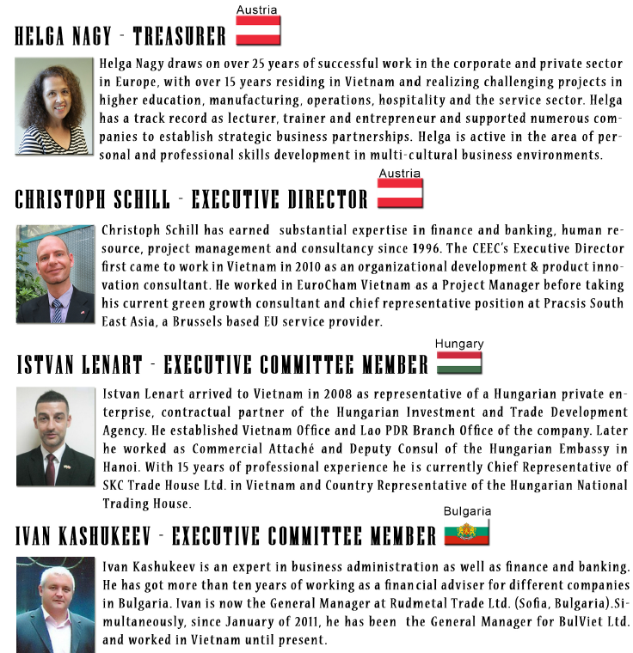
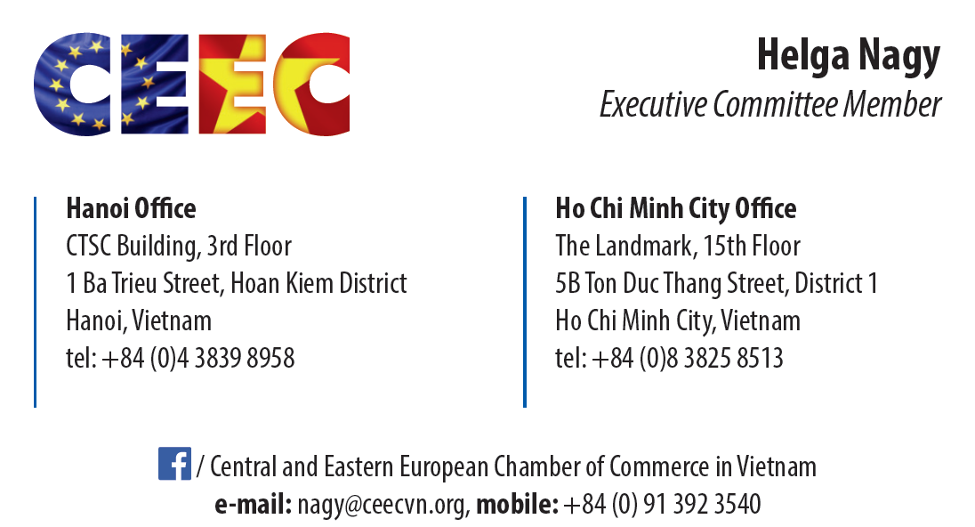
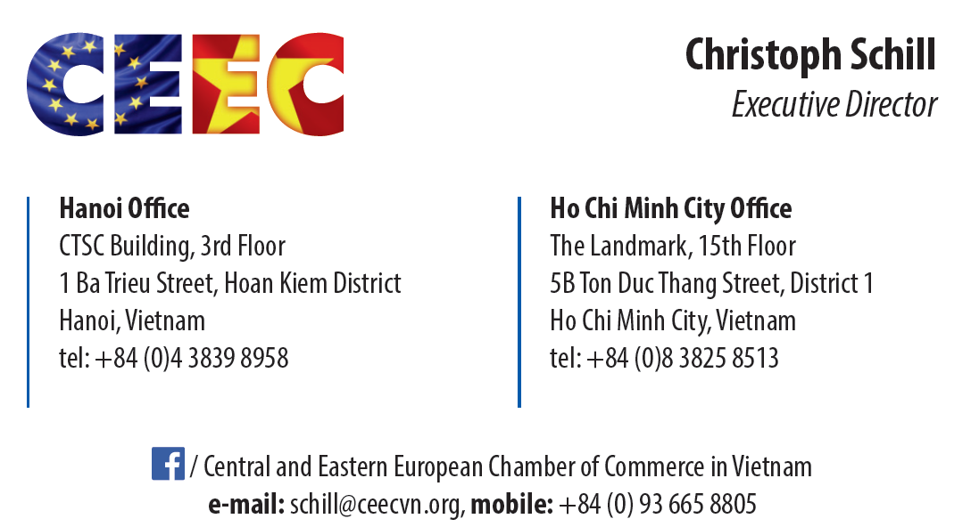
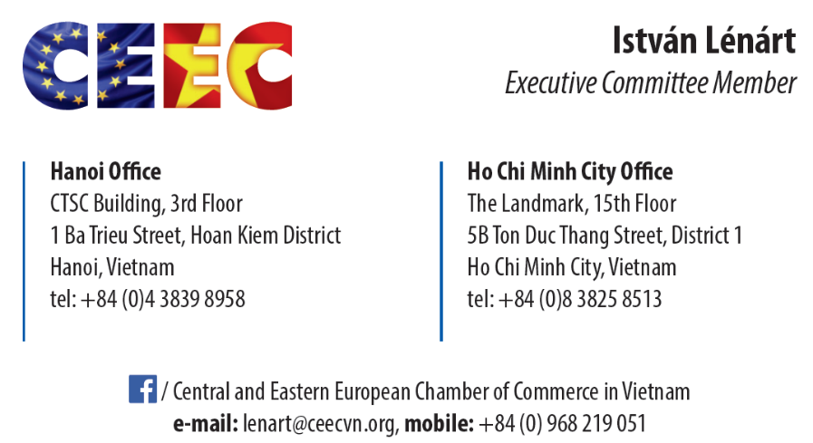
INTRODUCTION
CEEC EXECUTIVE COMMITTEE
Helga Nagy draws on over 25 years of successful work in the corporate and private sector in Europe, with over 15 years residing in Vietnam and realizing challenging projects in higher education, manufacturing, operations, hospitality and the service sector. Helga has a track record as lecturer, trainer and entrepreneur and supported numerous companies to establish strategic business partnerships. Helga is active in the area of personal and professional skills development in multi-cultural business environments.
Christoph Schill has earned substantial expertise in finance and banking, human resource, project management and consultancy since 1996. The CEEC’s Executive Director first came to work in Vietnam in 2010 as an organizational development & product innovation consultant. He worked in EuroCham Vietnam as a Project Manager before taking his current green growth consultant and chief representative position at Pracsis South East Asia, a Brussels based EU service provider.
Istvan Lenart arrived to Vietnam in 2008 as representative of a Hungarian private enterprise, contractual partner of the Hungarian Investment and Trade Development Agency. He established Vietnam Office and Lao PDR Branch Office of the company. Later he worked as Commercial Attaché and Deputy Consul of the Hungarian Embassy in Hanoi. He is the former Chief Representative of SKC Trade House Ltd. in Vietnam and Former Country Representative of the Hungarian National Trading House.

Slide 4
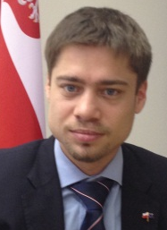
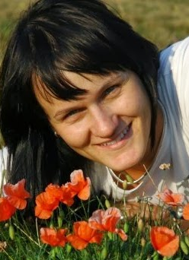
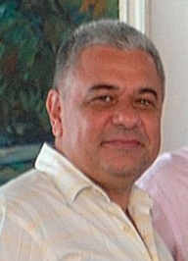
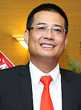
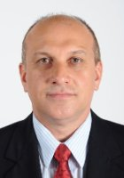
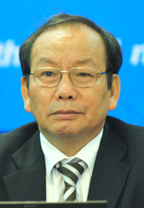
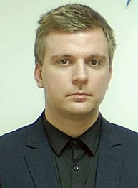
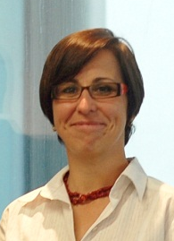
CEEC ADVISORY COMMITTEE
Ms. Ivana Belcakova
Third Secretary
Embassy of the Slovak Republic
12, Ba Huyen Thanh Quan, Ba Dinh District, Hanoi, Vietnam
Chairman: Mr. Mariusz Boguszewski
Economic Counselor
Embassy of the Republic of Poland in Hanoi
No.3, Chua Mot Cot Street, Hanoi
Mr. Aleksandar Aleksandrov
Mr. Dao Ha Trung
Honorary Consul
Honorary Consulate General of Austria
181A Dien Bien Phu, Da Kao Ward, District 1, HCMC
Head of Trade and Commercial Section
Embassy of the Republic of Bulgaria in Hanoi
№5 Nui Truc str., Van Phuc Hanoi, P.O. Box 10
Mr. Oleg Marinov
Head of Trade and Commercial Section
Commercial and Economic Office, Embassy of the Republic of Bulgaria
Vincom Center B, Floor 14, Office No.13, 45A Ly Tu Trong Street,
District 1, Ho Chi Minh City
Mr. Nguyen Dang Vang
Chairman
The Vietnam – Hungary Friendship Association
105A Quan Thanh Street, Ba Dinh District, Hanoi
Mr. Tamas Domokos
Economic, Investment and Trade Attaché
Consulate General of Hungary to Vietnam
22, Phung Khac Khoan, District 1, Ho Chi Minh City
Ms. Jana Herceg
Observer

Slide 5

CEEC ADMINISTRATION 2015
First AGM organized
Executive Committee of 7 members elected
Hanoi office located at No. 1, Ba Trieu, Hoan Kiem, Hanoi
Stamp released
Bank account opened
CEEC Services launched
Affiliation Signed
Mar
Apr
May
Oct
Nov
Dec
Website launched
Advisory Committee Elected
CEEC - EuroCham membership cards/membership book distributed
First staff recruited
Monthly Executive Committee Meeting

Slide 6
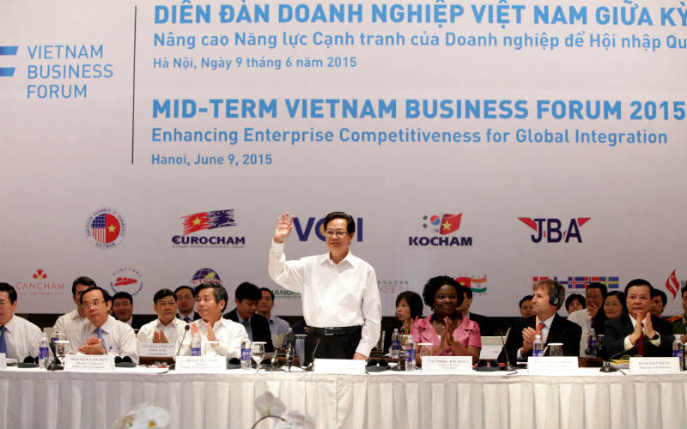
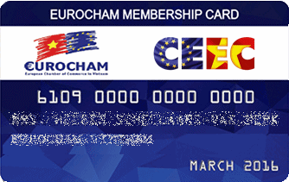
CEEC – EUROCHAM DUAL MEMBERSHIP
➔ dual membership and access to benefits of
a) small service and member oriented organization
b) and the large European, advocacy focused chamber
+ good relations with Vietnamese associations, officials, businesses
+ close contact with Nation-state embassies, trade consuls etc.

Slide 7


CEEC – EUROCHAM DUAL MEMBERSHIP
CEEC and CEEC’s members are eligible to access EuroCham’s facilities and data resources, including:
Access to the EuroCham White Book and Sector Committee advocacy groups
Free access to the EuroCham yearly Business Directory with all references and business contacts, including a page to introduce your company
Getting invited to all EuroCham events: seminars, workshops, networking activities, etc. while enjoying discounts which apply for all EuroCham members.
Receiving a membership card giving advantages and discounts in a number of restaurants, hotels or resorts, clubs, airlines, tour agencies, and other shops (app!)
Receiving EuroCham newsletter and getting access to weekly English news information

Slide 8


CEEC MEMBERSHIP 2015
Established with 30 members
Reached 43 members at year-end
JAN
FEB
DEC
NOV
MAR
CEEC
MEMBERSHIP
OCT
APRIL
2015
SEPT
MAY
AUG
JUN
JUL
After 6 months, CEEC has increased the number of members from 30 to 41 with companies and individuals coming from 9 different countries.

Slide 9






















CEEC CORPORATE MEMBERS

Slide 10






CEEC’s 2015 EVENTS
MARCH
CEEC FIRST AGM
APRIL
MAY
CEEC FIRST INFO EVENT
CEEC FIRST NETWORKING
JUNE
JULY
CEEC NETWORKING
AUGUST
SEPTEMBER
CEEC NETWORKING
CEEC FIRST SHARE AND EARN
OCTOBER
NOVEMBER
CEEC NETWORKING
SUPPORTED_EAST MEET WEST NETWORKING
SUPPORTED_HATCH FAIR! 2015
SUPPORTED_STARTING UP SAIGON
EUROCHAM X-MAS PARTY
DECEMBER

Slide 11
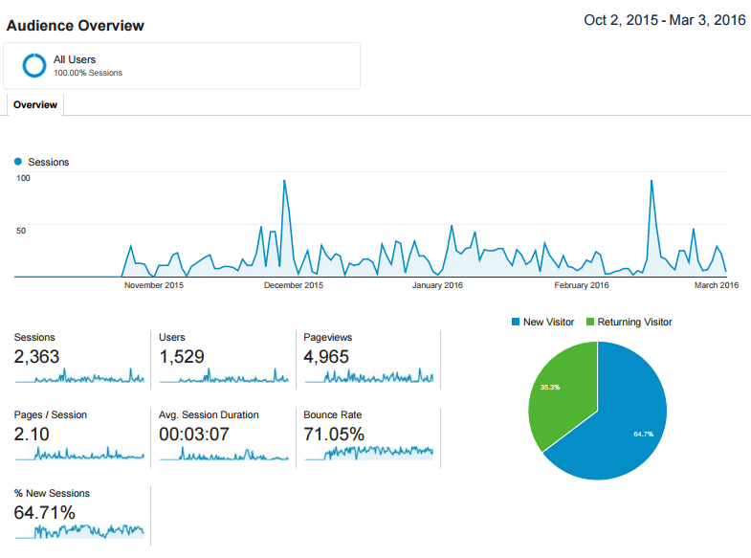
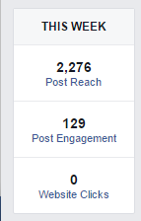
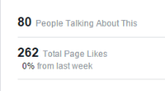
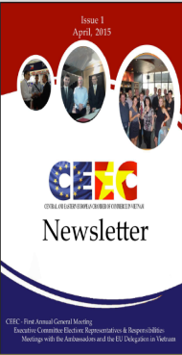
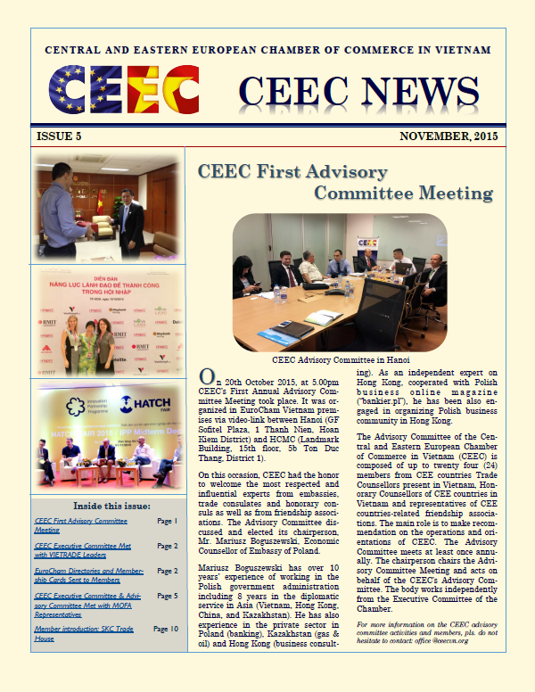
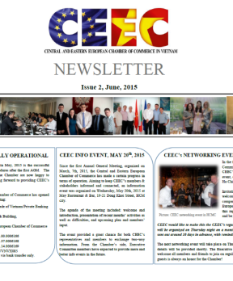
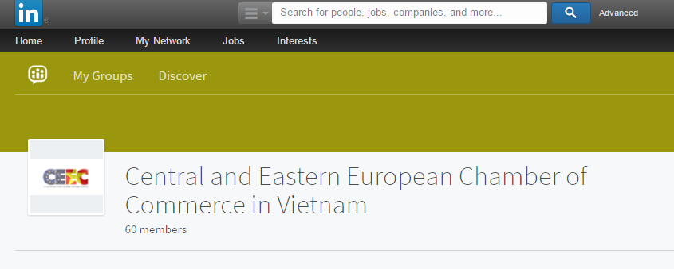
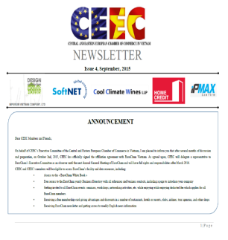
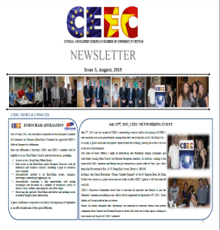
CEEC’s COMMUNICATIONS
OUR WEBSITE
OUR FACEBOOK
OUR NEWSLETTER
OUR LINKEDIN

Slide 12


CEEC’s 2015 EXTERNAL RELATIONS
Business Associations
Swiss Business Association, Advantage Austria, HAWEE, EVBN
International Corporations/Institutions
Chambers of Commerce
International Investment Bank
European Chamber of Commerce, Italian Chamber of Commerce, Czech Chamber of Commerce
Vietnamese Governmental Agencies
CEE Embassies, Consulates General, and Honorary Consulates
VIETRADE, VCCI, HCM Department of External Relations
Hungary, Austria, Bulgaria, Czech Republic, Poland
Friendship Associations
EU Delegation
Vietnam – Hungary Friendship Association

Slide 13
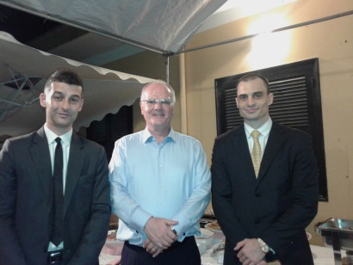
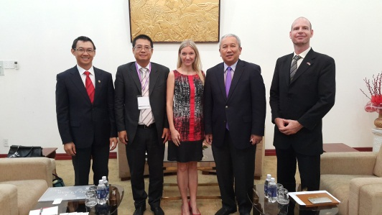
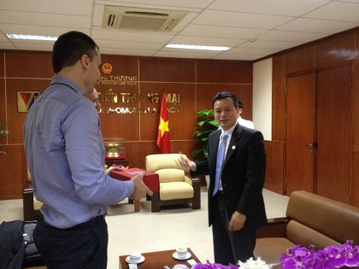

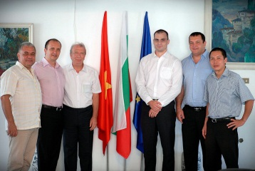
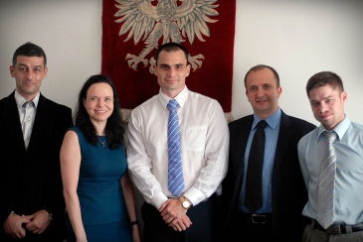
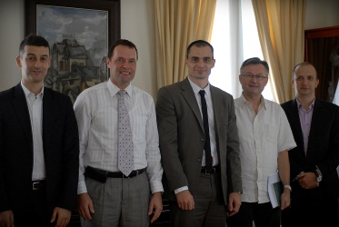
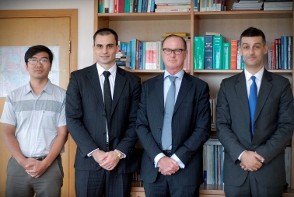
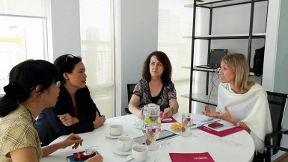
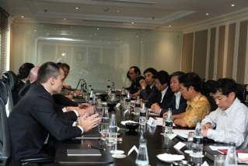
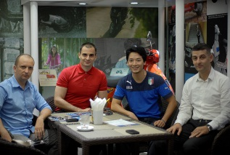
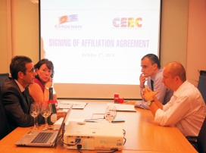
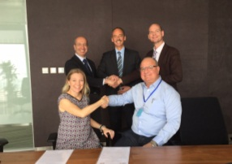
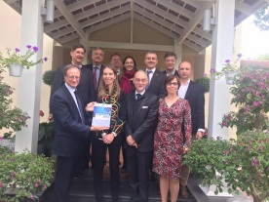
CEEC’s 2015 EXTERNAL RELATIONS
CEEC and H.E. Franz Jessen, Former Ambassador of EU Delegation to Vietnam at EU Residence
CEEC Visited HCM’s People Committee
CEEC met VIETRADE Leaders
CEEC visited H.E. Mr. Bruno Angelet (Ambassador-Head of EU Delegation to Vietnam) & Ms. Jana Herceg (Deputy Head of Trade and Economic Section)
CEEC Visited CEE’s Embassies in Vietnam
Meetings with other BAs

Slide 14
CEEC’s NEW LAUNCHED SERVICES
SERVICES | DESCRIPTION
 | Identify potential partners on request. The contact list will include: Company name, reference persons, address, tel., fax, email and website (if any).
Company background check | Provide a business information report.
Market study | The report includes 2-3 pages, provides an overview on a specific sector, key players, statistic data, market demands, import tax, regulation, preliminary recommendation.
Business match-making | Identify potential partners on request. The contact list will include: Company name, reference persons, address, tel., fax, email and website (if any), and verify the interest of selected partners toward the client.
Consulting | Local Business Culture, Business Strategies, and Foreign Investment Procedures.
Mission arrangement support
Company/Factory visit | Arrange tours that showcase a company's facilities' environmental, health, and safety standards.
Fair/Exhibition/Event/Seminar/Conference Support | Provide requested logistical supports.
SERVICE FEES
NON-MEMBER | MEMBER | ADDITIONAL DISCOUNT FOR MEMBER
X | X*(1-10%) | An amount equivalent to 50% Annual Membership Fee will be discounted from Total Service Fee incurred in 1 year.

Slide 15
THANK YOU!

