Slide 1
MARCH, 5th 2016
2016 OUTLOOK
By: Marko Moric
CEEC’s Chairman

Slide 2
MEMBERSHIP BASE
2015
2016
Increasing the number of members from Poland, Czech Republic and Bulgaria
Involving companies, individuals from other countries in CEE such as Serbia, Estonia, etc.
Industry Sectors | No. of members
Accounting and Consulting | 1
Banking and Finance | 1
Digital Media | 1
Education and Training | 1
Food and Beverages | 2
Import-Export | 2
Manufacturing | 1
Marketing Strategy, Advertising, Database Management | 1
Pharmaceuticals | 3
Professional Services Legal | 2
Renewable Energy, Energy Efficiency, Consultancy, Education & Training | 1
Telecommunications, IT infrastructure | 1
Tourism and Hospitality | 1
Trade and Consultancy | 1
Wooden House | 1
Diversifying industry sectors that CEEC members are operating in
Consulting and supporting CEEC members to get involve in EuroCham’s Sector Committee and VBI’s Sector Committee

Slide 3
EXTERNAL RELATIONS & COMMUNICATIONS
EXTERNAL RELATIONS
2015
2016
EU Delegation
EuroCham Vietnam
VIETRADE
PC HCM
SBA
GERMAN HOUSE
CEE’s Embassies
HAWEE
Advantage Austria
EU Delegation- EVBN
EuroCham Vietnam
VIETRADE (Sign MoU)
VCCI HCM
SBA (Sign MoU)
GERMAN HOUSE (Sponsorship)
CEE’s Embassies
Department of foreign affairs of provinces (MOFA) (Sign MoU)
COMMUNICATIONS
WEBSITE
LINKEDIN
FACEBOOK
NEWSLETTER
WEBSITE
LINKEDIN
FACEBOOK
NEWSLETTER
Increasing visibility by focusing more on PAID MEDIA (advertisement, article, etc.) and EARNED MEDIA (mentions, share, posts)

Slide 4
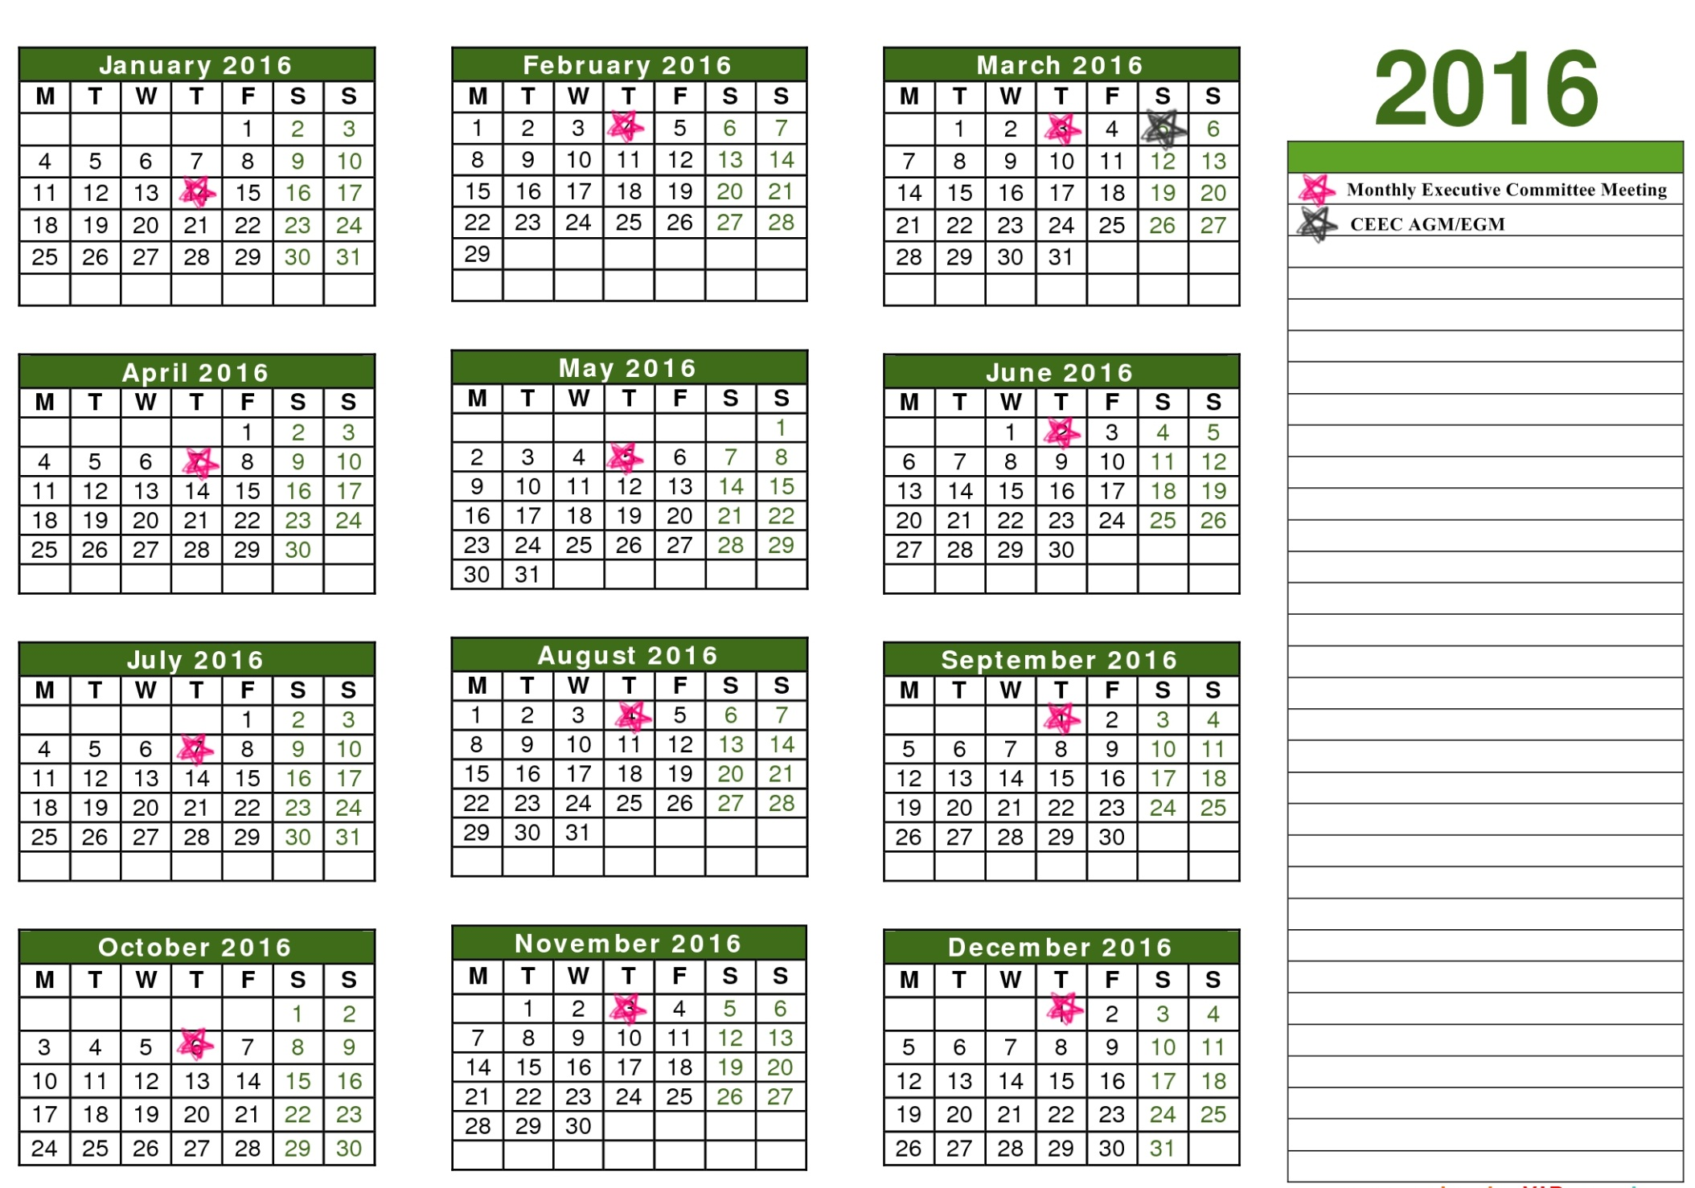
CEEC’s ACTIVITIES 2016
Feb, 04th: MoU signing with SBA
Bi-Monthly Share & L(Earn): tbd
Mar, 10th: Networking with SBA
EuroCham’s Netplus by CEEC: tbd
EuroCham’s Food Festival: tbd
To be continued...

Slide 5
EUROCHAM’s ACTIVITIES 2016
HCMC | Jan | Feb | Mar | Apr | May | Jun
Business | Vietnam Biz Outlook under new leadership of Vietnam | Enterprise Risk Management (ERM), an update on what companies are doing in Vietnam | 10.30: AGM | Cambo-Laos-Myanmar-Vietnam – Market update | KPMG Annual Tax Update | M&A and Capital Market:
 | Tax Dialogue with HCM Dept |  | - 08.03 Climate change and woman leadership (with Mary Robinson) |  | Vietnam Transfer Pricing Update | SC Mid-year review
Advocacy | 13 or 27.01: Whitebook launch | New Work Permit Degree briefing |  | 26. 04: IPR breakfast briefing | Dialogue with MPI
 | 05.01: Media training for in-house (cancelled) | Meeting with National Financial Supervisory Committee Chairman | FTA technical seminar (topic to be defined) |  | FTA technical seminar (topic to be defined)
Training |  |  | Business skill-tbd (Finance for non-Finance) |  | Business skill-tbd
Social | NetPlus by GBA |  | NetPlus by BeLuxCham |  | NetPlus by ICham
Incoming missions / Province visit/Others | 20.01: Orientation Night |  |  |  | 18.05: Orientation Night
Europe/Intl trips | 11-22.01: IT mission (EVBN) |  | 15-18.03: Agro mission (EVBN) |  | 20-22.05: EBO meeting Tbc: MNC-SME match-making (EVBN)
HANOI | Jan | Feb | Mar | Apr | May | Jun
Business | Vietnam Biz Outlook under new leadership of Vietnam | Vietnam’s Monetary Policy: Any Updates? | 10.03: AGM | Cambo-Laos-Myanmar-Vietnam event – Market update | KPMG Annual Tax Update | M&A and Capital Market:
 | TPP and FTA: Comparison – Preparation |  | Procurement Law and its new impact on businesses | IPR breakfast briefing | Vietnam Transfer Pricing Update | Vietnam Economic: Half Year Review
Advocacy | 13 or 26. 01: Whitebook launch | New Work permit Degree briefing |  |  |  | VBF Mid term
 | 04.01: Journalist workshop (cancelled) 03.01: Media training for in-house (cancelled) | FTA technical seminar (topic to be defined) | Special dialogue with Key Ministries + SC presentation (Dialogue with DPM) | FTA technical seminar (topic to be defined) | Special dialogue with Key Ministries + SC presentation (Dialogue with MPI) | FTA technical seminar (topic to be defined)
Training |  |  |  | Business skill-tbd |  | Business skill-tbd
Social | Co-Chamber Monthly Networking | Co-Chamber Monthly Networking | Co-Chamber Monthly Networking | Co-Chamber Monthly Networking | Co-Chamber Monthly Networking | Co-Chamber Monthly Networking
Incoming missions / Province visit/Others |  |  |  |  | Tbc: Orientation Night
Europe/Intl trip | 11-22.01: IT mission (EVBN) |  | 15-18.03: Argo mission (EVBN) |  | 21 or 28.05: Food Festival

Slide 6
EUROCHAM’s ACTIVITIES 2016
HCMC | Jul | Aug | Sep | Oct | Nov | Dec
Business | Social media update | Retail Martket and Consumer Trends | Vietnam logistics market Update and Outlook | Salary Survey | Real Estate Market and Investment Guide | SC Review and Outlook
 | Site Excursion |  | Out-sourcing topic | Risk Management
Advocacy |  |  | Customs Dialogue |  | Meeting with HCMC PC leaders
 | FTA technical seminar (topic to be defined) |  | FTA technical seminar (topic to be defined) |  | FTA technical seminar (topic to be defined)
Training | Business skill-tbd (Sales & Marketing) |  | Business skill-tbd (Franchising) |  | Business skill-tbd
Social |  | NetPlus by CCIFV | NetPlus by CEEC | NetPlus by DBAV | EBO meeting | Xmas Party
Incoming missions / Province visit/Others |  | 25.08: Appreciation Night | 21.09: Orientation Night
Europe/Intl trip | 02.07 : EuroCham Challenge 2016 |  | Tbc: Healthcare mission (EVBN)
HANOI | Jul | Aug | Sep | Oct | Nov | Dec
Business | Social Media Update | Retail Market and Consumer Trends | The Stock Market in Vietnam: Updates | Dialogue with World Bank |  | SC Review and Outlook
 | Site Excursion |  |  | Salary Survey
Advocacy | Special dialogue with Key Ministries + SC presentation (Dialogue with MoIT) |  |  | Dialogue with State-bank | Meeting with HN PC | VBF
 |  | FTA technical seminar (topic to be defined) | Special dialogue with Key Ministries + SC presentation (Dialogue with Economic Committee of National Assembly) | FTA technical seminar (topic to be defined) | Special dialogue with Key Ministries + SC presentation (MOF Dialogue) | FTA technical seminar (topic to be defined)
Training |  | Business skill-tbd |  | Business skill-tbd |  | Business skill-tbd
Social | Monthly co-chambers networking | Monthly co-chambers networking | Monthly co-chambers networking | Monthly co-chambers networking | Monthly co-chambers networking | Xmas Party
Incoming missions / Province visit/Others |  |  |  |  | Tbc: Orientation Night
Europe/Intl trip |  |  | Tbc: Healthcare mission (EVBN)

Slide 7
2016 SERVICES
2015
2016
Company contact list
Company background check
Market study
Business match-making
Consulting
Mission arrangement support
Company/Factory visit
Fair/Exhibition/Event/Seminar/Conference Support
CEEC SOFTLANDING PROGRAM
VIETNAM DESK IN EUROPE
SERVICES FOR UNIVERSITIES

Slide 8
HUMAN RESOURCES AND ADMINISTRATION
2015
2016
OFFICE MANAGER HANOI
OFFICE MANAGER HCM
EXECUTIVE COMMITTEE MEMBERS
EXECUTIVE COMMITTEE MEMBERS

Slide 9
THANK YOU!

